Slide 1

Chapter 6
Deviance
SOC 2020
Sixth Edition

Slide 2
What’s to Come?
Social Control.
Deviance.
Crime.
Sociological Perspectives on Crime and Deviance.

Slide 3
As You Read
How do groups maintain social control?
What is the difference between deviance and crime?
How do sociologists explain deviance and crime?

Slide 4
Social Control
Social control: society’s power to limit deviance by enforcing conformity to expected norms and values.
Those around us use positive and negative sanctions to encourage and discourage particular behaviors.
Great power potentially rests in the hands of those with authority over us.

Slide 5
Conformity and Obedience
Conformity: abiding by the norms of our peers even though they have no direct authority over us.
Obedience: doing what a person in a position of authority over you says you should.
Social psychologist Stanley Milgram conducted a famous experiment to assess people’s willingness to obey even when asked to do something harmful.
Concluded that we are willing to do things we would otherwise not do, including inflicting pain, when a person in a position of authority tells us to do so.

Slide 6
Informal and Formal Social Control
Informal social control: the use of interpersonal cues through everyday interaction to enforce norms.
Smiles, laughter, crossed arms, frowns, ridicule.
Formal social control: the imposition of sanctions, whether positive or negative, by officially recognized authorities in order to enforce norms.
The interplay between formal and informal social control is complicated because we sometimes have to balance one source of control against another.

Slide 7
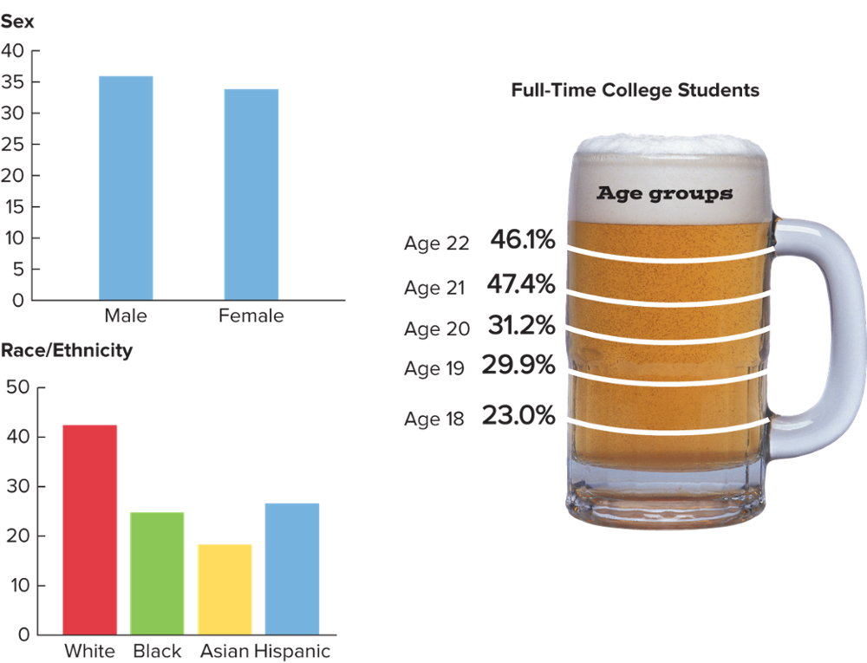
Informal and Formal Social Control: Binge Drinking on Campus
Note: Binge drinking was defined as drinking five drinks or more for men, or four drinks or more for women, on the same occasion at least once in the past 30 days. White, Black, and Asian categories do not include Hispanics. Source: SAMHSA 2018. Photo: ©Comstock/Jupiter Images
Access the text alternative for slide images.

Slide 8
Law and Society
Some norms are so important to a society that they are formalized into laws—formal norms enforced by the state.
Arresting, prosecuting, and convicting a person who breaks the law represents one of the most powerful means of formal social control available.
In diverse societies, the establishment of laws inevitably generates conflicts over whose values should prevail.
Example: the “war on drugs.”

Slide 9
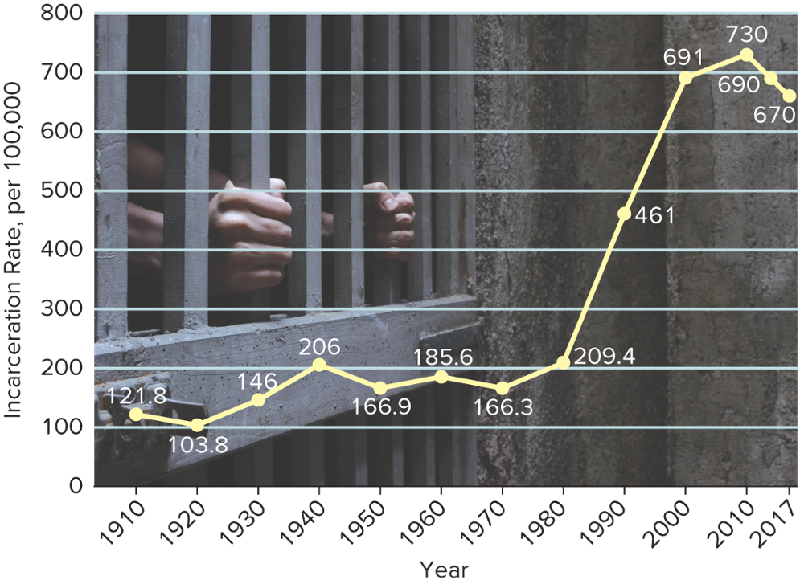
Law and Society: U.S. Incarceration Rates, 1910–2017
Note: Incarceration rates represent the number of persons in prison or jail per 100,000 people in the U.S. population. Source: Justice Policy Institute 2000:4. Photo: AZemdega/E+/Getty Images
Access the text alternative for slide images.

Slide 10
Deviance
Deviance: behavior that violates standards of conduct or expectations of a group or society.
We are all deviant from time to time, as we all violate common social norms in certain situations.
As a society, we decide how deviant is too deviant.

Slide 11
What Behavior Is Deviant?
What is considered deviant depends on the context.
Example: piracy and Game of Thrones.
It is important to remember that social change occurs when people choose to act differently.
Change is often difficult to enact, however, because those with the greatest status have the capacity to define what is acceptable and what is deviant.

Slide 12
Deviance and Social Stigma
Stigma: labeling individuals or members of a group as less than whole persons due to some attribute that marks them as different in the eyes of others.
Stigmatization justifies discrimination, thereby acting as a form of social control.
People may be stigmatized for past behaviors.
A person need not be guilty of a crime to be stigmatized.

Slide 13
5 Movies on Deviance
The Purge.
Once a year, for 12 hours, all crime is legal.
Liar, Liar.
What if honesty was your only option?
Compliance.
When it comes to obedience, how far would you go?
I Am Not a Witch.
An eight-year-old-girl is accused of being a witch.
Ghost World.
A prank by two outcast teenagers takes an unexpected turn.

Slide 14
Crime
Crime: a violation of criminal law for which some governmental authority applies formal penalties.
Crimes that violate the central mores of society often result in harsh punishments.
Constitute attacks on core social values, such as life, liberty, and the pursuit of happiness.
Example: murder.

Slide 15
Official Crime Reports 1
The FBI tracks the frequency of crime in the United States using what it calls its “Crime Clock.”
Property crime occurs on average every 4.1 seconds.
Murder occurs every 30.5 minutes.
Trends in Crime.
The FBI provides a more detailed account in its annual Uniform Crime Reports (UCR).
Index crimes: eight types of crime reported on annually.
Violent crime: murder, forcible rape, robbery, and aggravated assault.
Property crimes: burglary, larceny-theft, motor vehicle theft, and arson.

Slide 16
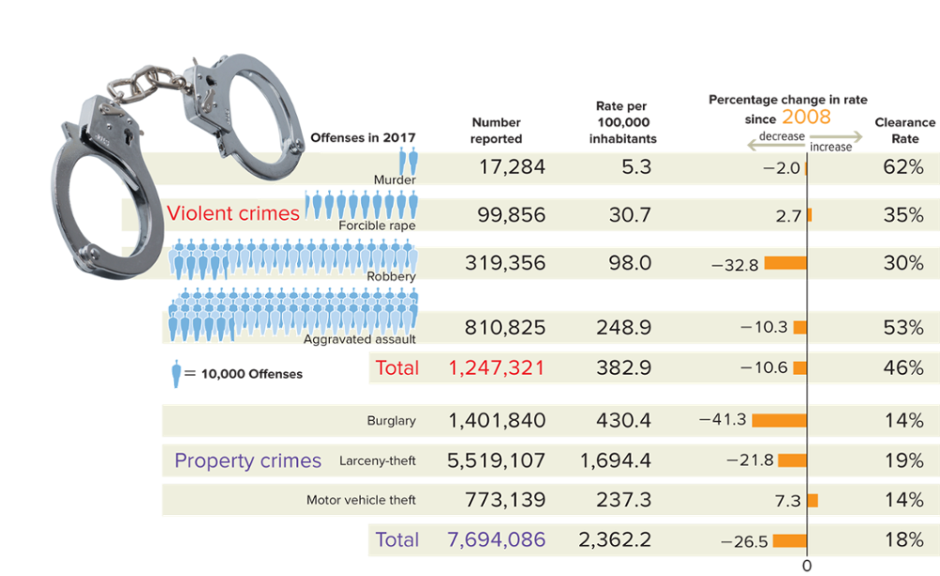
Official Crime Reports: FBI Uniform Crime Reports Data
Note: Insufficient data are available on arson to estimate accurate totals. The official definition for rape changed in 2013. The percentage change data for rape uses the legacy definition to provide an appropriate comparison over time. Clearance rate refers to the percentage of crimes reported to police that were cleared by arrest or exceptional means. Source: U.S. Department of Justice 2018a:Tables 1, 1A, & 25. Photo: D. Hurst/Alamy
Access the text alternative for slide images.

Slide 17
Official Crime Reports 2
Trends in Crime, continued.
In the past 10 years, crime rates have fallen in most major categories.
Sociologists seek to identify possible causal factors.
Aging population.
Economic changes.
Enhanced community-oriented policing.
Increased incarceration rates.
New prison education programs.
The likelihood that a crime will be “solved” varies by the type of offense.

Slide 18
Official Crime Reports 3
Victimization Surveys.
Not all crimes that are committed are reported to the police.
Victimization surveys: questionnaires or interviews that ask representative samples of the population whether or not they have been victims of crime.
Some crimes are more likely to be reported than others: less than half the victims of violent crime contact the police.
Members of racial and ethnic minority groups often distrust law enforcement agencies.
Many women do not report rape or spousal abuse out of fear they will be blamed.

Slide 19
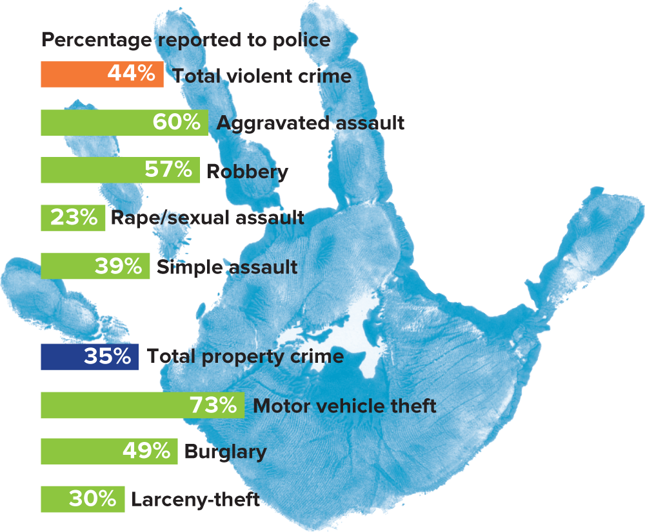
Official Crime Reports: Crimes Reported to Police
Note: Percentages based on the National Crime Victimization Survey for 2016. Source: Morgan and Kena 2018:Table 4. Photo: McGraw-Hill Education
Access the text alternative for slide images.

Slide 20
White-Collar Crime
White-collar crime: illegal acts committed by high-status individuals who use their positions of power and influence for their own benefit.
Example: Bernie Madoff.
Frequently, convicted offenders receive less harsh punishments than those for more common street crimes.
The definition has expanded to include crimes by corporations and businesses.

Slide 21
Victimless Crimes
Victimless crimes: a term used by sociologists to describe the willing exchange among adults of widely desired, but illegal, goods and services.
Supporters of decriminalization are troubled by attempts to legislate a moral code for adults.
Example: marijuana laws.
Critics object to the notion that these crimes are “victimless” and argue that society must not give tacit approval to harmful behavior.
Feminist sociologists contend that prostitution and the more disturbing aspects of pornography treat women as objects.

Slide 22
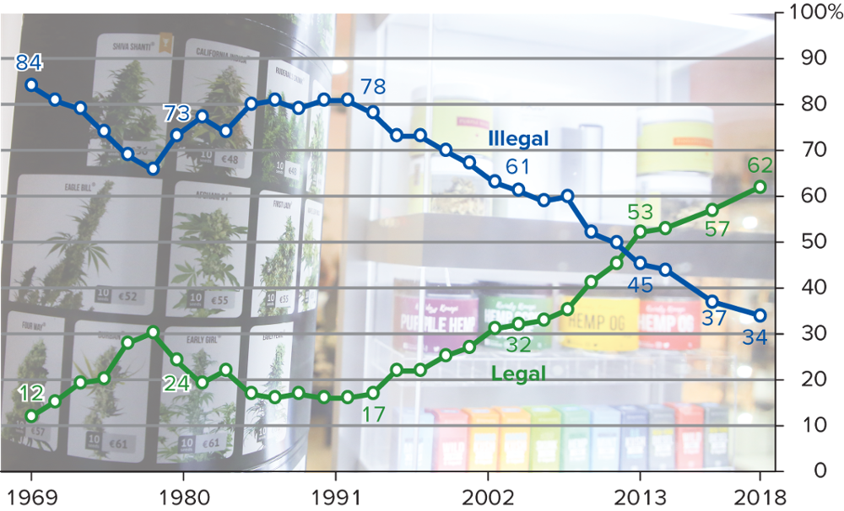
Victimless Crimes: Marijuana Legalization, 1969–2018
Note: Responses are to the question “Do you think the use of marijuana should be made legal, or not?” Source: Hartig and Geiger 2018. Photo: Beata Zawrzel/NurPhoto/Getty Images
Access the text alternative for slide images.

Slide 23
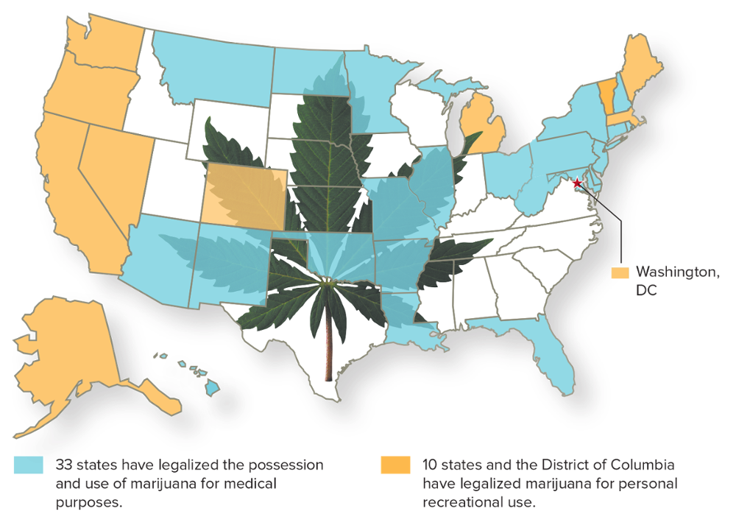
Victimless Crimes: Marijuana Laws by State
Source: National Conference of State Legislatures 2018a. Photo: Brand X Pictures/Getty Images
Access the text alternative for slide images.

Slide 24
Organized Crime
Organized crime: the work of a group that regulates relations among criminal enterprises involved in illegal activities.
Prostitution, gambling, and the smuggling and sale of illegal drugs.
Historically, organized crime has provided a means of upward mobility for struggling groups.
Ethnic succession of organized crime operations has become complex in today’s diverse world.
International organized crime includes drug and arms smuggling, money laundering, and trafficking in illegal immigrants and stolen goods.

Slide 25
International Crime 1
Transnational Crime.
Organized criminal networks are increasingly global.
Transnational crime: crime that occurs across multiple national borders.
One way to fight such crime has been through multilateral cooperation, such as with the International Criminal Police Organization (Interpol).
Nations are often hesitant to cooperate on some matters over concern about encroachments on their national judicial systems and concern over their national security.

Slide 26
International Crime 2
International Crime Rates.
Violent crimes tend to be much more common in the United States than in Western Europe.
Sociologist Elliot Currie has suggested one factor is the greater emphasis placed on individual economic achievement in the United States.
Violent crime remains a serious problem in nations around the world.

Slide 27
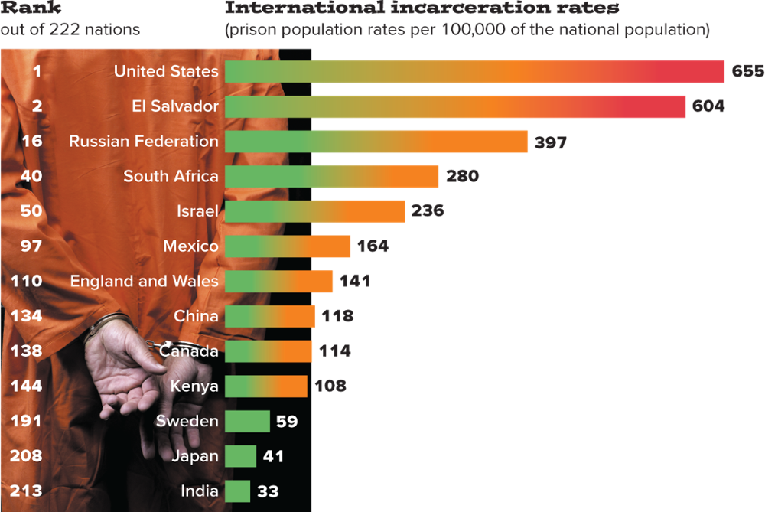
International Incarceration Rates
Access the text alternative for slide images.
Source: Institute for Criminal Policy Research 2018. Photo: Trista Weibell/Getty Images

Slide 28
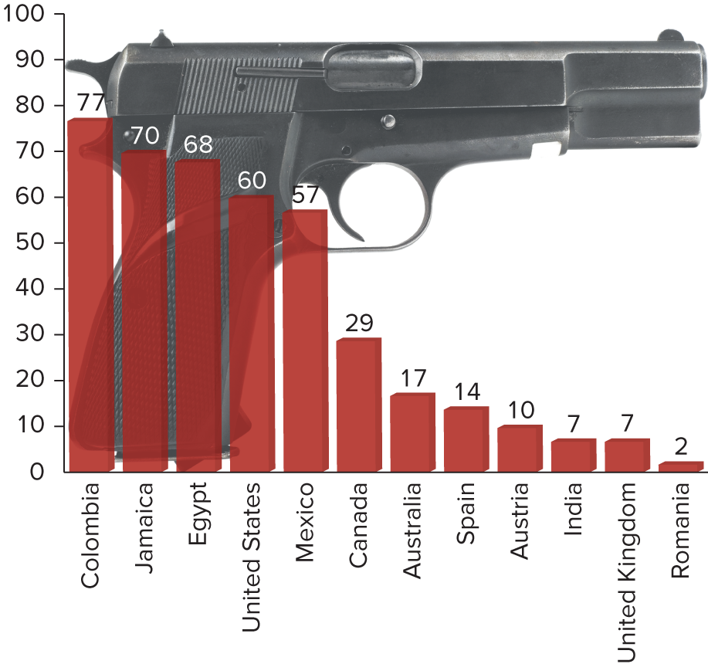
International Gun Homicide Rates
Note: The number represents the percentage of homicides committed using firearms. Source: UNODC 2014. Photo: ©Stockbyte/PunchStock
Access the text alternative for slide images.

Slide 29
5 Movies on Crime
Three Billboards Outside Ebbing, Missouri.
A mother demands that a local sheriff do his job.
Charm City.
On the frontlines of violence in Baltimore.
Hell or High Water.
Two brothers turn to robbing banks to save their family farm.
Incarcerating US.
An exploration of mass incarceration in the United States.
The Shawshank Redemption.
Some birds aren’t meant to be caged.

Slide 30
Sociological Perspectives on Crime and Deviance
As part of how and why society holds together, sociologists have always been interested in why people violate accepted social norms.
There is no one, simple, universal theory that explains all such acts.

Slide 31
Functions of Crime and Deviance 1
Durkheim’s Functions of Deviance.
No act is inherently criminal.
Because some form of deviance exists in all societies, it must serve a positive social function.
Positive effects:
Collectively labeling acts as deviant clarifies our shared beliefs and values.
Punishment creates solidarity in opposition to the offender and functions as a deterrent.
Deviant acts might lead us to recognize the limits of our existing beliefs and practices.
When social integration is weak, as in a period of anomie, people are freer to pursue deviant paths.

Slide 32
Functions of Crime and Deviance 2
Merton’s Strain Theory.
Strain theory of deviance: a theory of deviance as an adaptation of socially prescribed goals or of the means governing their attainment, or both.
Five basic forms of adaptation to cultural expectations:
Conformist.
Innovator.
Ritualist.
Retreatist.
Rebel.

Slide 33
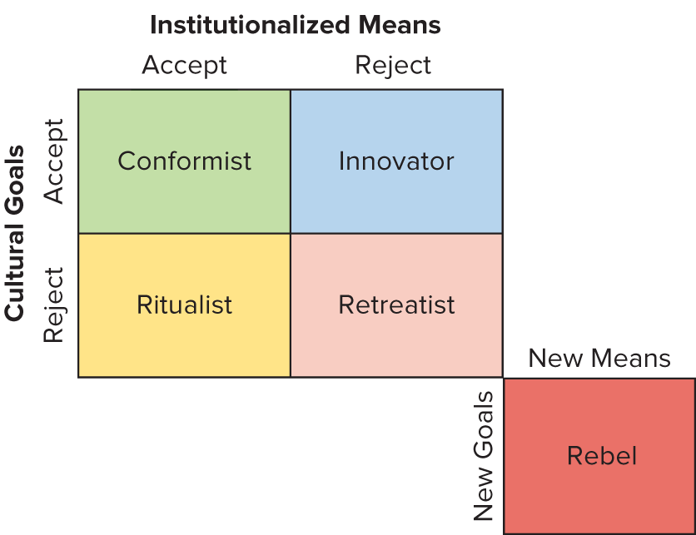
Functions of Crime and Deviance: Merton’s Typology of Deviance
Access the text alternative for slide images.
Source: Merton 1968.

Slide 34
Functions of Crime and Deviance 3
Hirschi’s Social Control Theory.
American sociologist Travis Hirschi asks why people don’t commit crimes.
Social control theory: a theory of deviance that posits that the social bonds we share with other members of society lead us to conform to society’s norms.
Four key elements strengthen social bonds:
Attachment.
Commitment.
Involvement.
Belief.

Slide 35
Interpersonal Interaction and Defining Deviance 1
Sutherland’s Cultural Transmission Theory.
Cultural transmission: a school of criminology that argues that criminal behavior is learned through social interactions.
Differential association: a theory of deviance that holds that violation of rules results from exposure to attitudes favorable to criminal acts.
This approach directs our attention to the paramount role of social interaction and context in increasing a person’s motivation to engage in deviant behavior.

Slide 36
Interpersonal Interaction and Defining Deviance 2
Social Disorganization Theory.
Social disorganization theory: the theory that attributes increases in crime and deviance to the absence or breakdown of communal relationships and social institutions.
Family, school, church, local government.
Broken windows hypothesis: the theory that physical signs in a community or neighborhood indicate a corresponding breakdown of social order within which crime and deviance are likely to thrive.

Slide 37
Interpersonal Interaction and Defining Deviance 3
Labeling Theory.
Sociologist William Chambliss conducted a study of deviance in which groups of boys who engaged in similar deviant acts were treated differently according to whether they were identified as “Saints” or “Roughnecks.”
Labeling theory: an approach to deviance that attempts to explain why certain people are viewed as deviants while others engaged in the same behavior are not.
Labeling theory is also called the societal-reaction approach—based on the idea that it is the response to an act, not the act itself, that determines deviance.
Example: the practice of racial profiling.

Slide 38
Conflict, Power, and Criminality 1
Richard Quinney: Crime is defined as such by legislators who may be influenced by the economic elites to advance their interests.
Race and Class.
Suspects are treated differently based on their racial, ethnic, or social class background.
Differential justice: variations in the way social control is exercised over different groups.
In death penalty cases, poor people cannot afford adequate representation; defendants are more likely to be sentenced to death if the victims were White; and Black defendants are more likely to face execution.

Slide 39
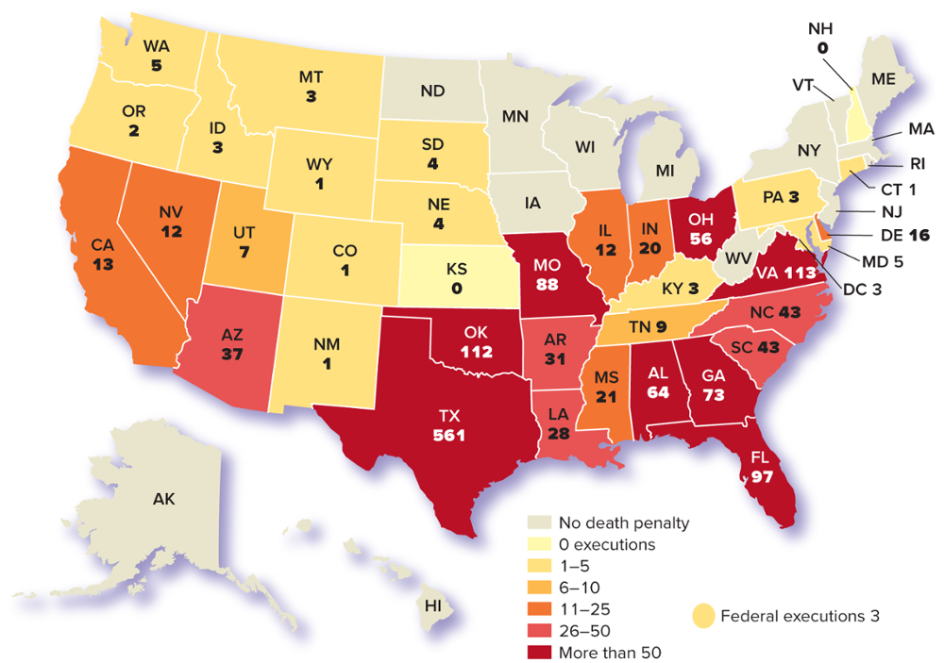
Conflict, Power, and Criminality: Executions by State since 1976
Note: The death penalty was reinstated by the U.S. Supreme Court in 1976. Data current as of May 2019. New Mexico abolished the death penalty in 2009. California established a moratorium on the use of the death penalty in March 2019. Source: Death Penalty Information Center 2019.
Access the text alternative for slide images.

Slide 40
Conflict, Power, and Criminality 2
Gender.
Criminologists Meda Chesney-Lind and Gillian Balfour: the existing approaches to deviance were developed with only men in mind.
In some parts of the world, laws regarding rape and marriage continue to point toward inequality for women.
As women take on more active and powerful roles, the gender differences in deviance and crime have narrowed.

Slide 41
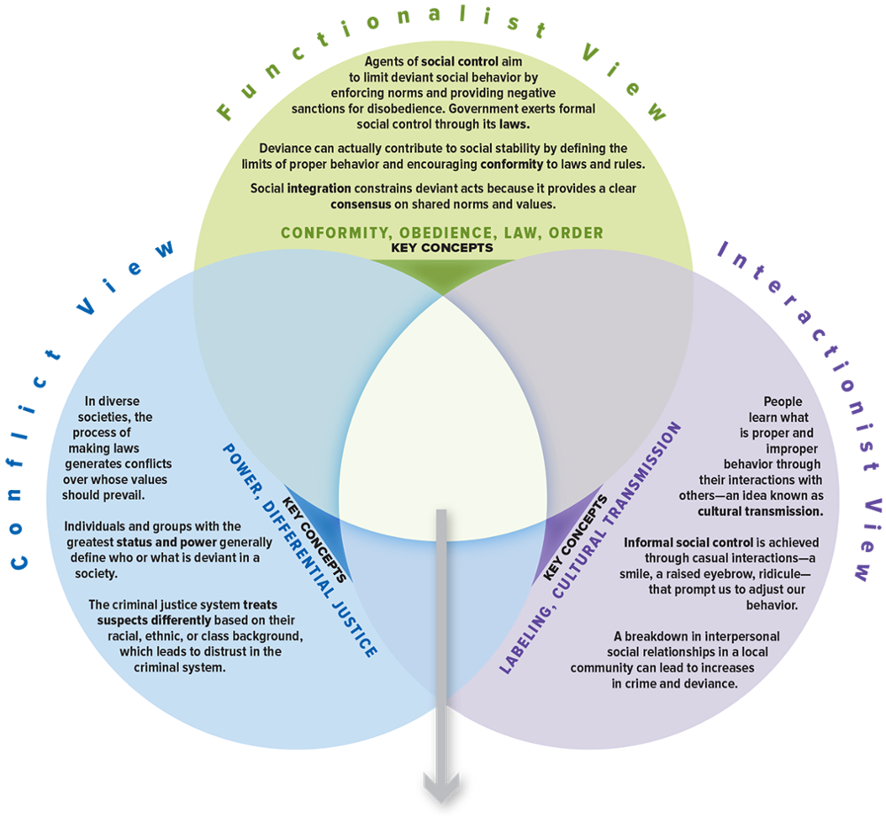
SOC VIEWS on Deviance
Access the text alternative for slide images.

Slide 42
Make the Connection 1
How would each perspective approach, explore, and explain mass public shootings in the United States?
What perspective do you think provides the best explanation for the results of Milgram’s experiment on obedience? Why?
Describe victimless crime from the point of view of each of the three perspectives, using one of the following examples in your response: drug use, gambling, or prostitution.

Slide 43
Make the Connection 2
Which perspective best describes the way you learned proper social behavior? Were social norms socialized and internalized (functionalist), imposed by powerful authority figures (conflict), or learned from observing others (interactionist)? Provide examples.

Slide 44
End of Main Content

Slide 45
Accessibility Content: Text Alternatives for Images

Slide 46
Informal and Formal Social Control: Binge Drinking on Campus - Text Alternative
Return to parent-slide containing images.
The mug depicts percentage of binge drinking on campus by full-time college students belonging to various age groups. The illustration infers the data in the following format: age group, percentage of binge drinking. At age 18, 23.0 percent; at age 19, 29.9 percent; at age 20, 31.2 percent; at age 21, 47.4 percent; and at age 22, 46.1 percent.
The graph for sex represents that 36 percent of male and 34 percent of female were indulged in binge drinking. The data is approximated.
The graph for race/ethnicity represents that 43 percent of Whites, 24 percent of Blacks, 17 percent of Asians, and 27 percent of Hispanics were indulged in binge drinking. The data is approximated.
Return to parent-slide containing images.

Slide 47
Law and Society: U.S. Incarceration Rates, 1910–2017 - Text Alternative
Return to parent-slide containing images.
The horizontal axis represents the years from 1910 to 2017, with a 10 months interval till 2010 followed by 2017. The vertical axis represents incarceration rate, per 100,000. The graph infers the data in the following format: year, incarceration rate. 1910, 121.8; 1920, 103.8; 1930, 146; 1940, 206; 1950, 166.9; 1960, 185.6; 1970, 166.3; 1980, 209.4; 1990, 461; 2000, 691; 2010, 730; 2014, 690; and 2017, 670. The graph is inscribed on a photograph of a two hands holding the jail bars.
Return to parent-slide containing images.

Slide 48
Official Crime Reports: FBI Uniform Crime Reports Data - Text Alternative
Return to parent-slide containing images.
The report infers the following data for violent crimes. The number of murders reported in 2017 was 17,284 and its rate per 100,000 inhabitants was 5.3. Since 2018, there was a decreased of 2.0 percent in the murder rates and the clearance rate summed to 62 percent. The number of forcible rapes reported in 2017 was 99,856 and its rate per 100,000 inhabitants was 30.7. Since 2018, there was an increase of 2.7 percent in the forcible rape rates and the clearance rate summed to 35 percent. The number of robberies reported in 2017 was 319,356 and its rate per 100,000 inhabitants was 98.0. Since 2018, there was a decreased of 32.8 percent in the robbery rates and the clearance rate summed to 62 percent. The number of aggravated assaults reported in 2017 was 810,825 and its rate per 100,000 inhabitants was 248.9. Since 2018, there was a decreased of 10.3 percent in the aggravated assault rates and the clearance rate summed to 53 percent. The total number of offenses reported in 2017 was 1,247,321and its rate per 100,000 inhabitants was 382.9. Since 2018, there was a decreased of 10.6 percent in the total number of offense rates and the clearance rate summed to 46 percent.
The report infers the following data for property crimes. The number of burglaries reported in 2017 was 1,401,840 and its rate per 100,000 inhabitants was 430.4. Since 2018, there was a decreased of 41.3 percent in the burglary rates and the clearance rate summed to 14 percent. The number of larceny-thefts reported in 2017 was 5,519,107 and its rate per 100,000 inhabitants was 1,694. Since 2018, there was a decreased of 21.8 percent in the larceny-theft rates and the clearance rate summed to 19 percent. The number of motor vehicle thefts reported in 2017 was 773,139 and its rate per 100,000 inhabitants was 237.3. Since 2008, there was an increase of 7.3 percent in the motor vehicle theft rates and the clearance rate summed to 14 percent. The total number of property crimes reported in 2017 was 7,694,086 and its rate per 100,000 inhabitants was 2,362.2. Since 2018, there was a decreased of 26.5 percent in the total number of property crime rates and the clearance rate summed to 18 percent.
Return to parent-slide containing images.

Slide 49
Official Crime Reports: Crimes Reported to Police - Text Alternative
Return to parent-slide containing images.
The bar graph infers the data in the following format: crime, percentage reported to police. Larceny-theft, 30 percent; burglary, 49 percent; motor vehicle theft, 73 percent; total property crime, 35 percent; simple assault, 39 percent; rape/sexual assault, 23 percent; robbery, 57 percent; aggravated assault, 60 percent; and total violent crime, 44 percent.
Return to parent-slide containing images.

Slide 50
Victimless Crimes: Marijuana Legalization, 1969–2018 - Text Alternative
Return to parent-slide containing images.
The horizontal axis represents 6 years from 1969 to 2018 with varying intervals. The vertical axis represents percentage and it ranges from 0 to 100, in increments of 10. The graph infers the data in the following format: year, percentage who said use of marijuana should be made legal, and percentage who said the use of marijuana should be made illegal. 1969, 12 percent, 84 percent; 1980, 24 percent, 73 percent; 1993, 17 percent, 78 percent; 2004, 32 percent, 61 percent; 2013, 53 percent, 45 percent; 2015, 57 percent, 37 percent; and 2018, 62 percent, 34 percent.
Return to parent-slide containing images.

Slide 51
Victimless Crimes: Marijuana Laws by State - Text Alternative
Return to parent-slide containing images.
33 states have legalized the possession and use of marijuana for medical purposes. 10 states and the District of Columbia have legalized marijuana for personal recreational use. The map infers the following data. The states which legalized the possession and use of marijuana for medical purposes are Washington, Oregon, California, Nevada, Colorado, Michigan, Vermont, Maine, Massachusetts, Washington D.C., and Alaska. The states which legalized marijuana for personal recreational use are Montana, North Dakota, Minnesota, Illinois, Missouri, Arkansas, Oklahoma, Arkansas, Louisiana, New Mexico, Arizona, Ohio, Pennsylvania, New York, New Hampshire, Rhode Island, Connecticut, New Jersey, Delaware, Maryland, West Virginia, Florida, and Hawaii.
Return to parent-slide containing images.

Slide 52
International Incarceration Rates - Text Alternative
Return to parent-slide containing images.
The chart infers the data in the following format: country, international incarceration rates (prison population rates per 100,000 of the national population), and rank out of 222 nations. India, 33, 213; Japan, 41, 208; Sweden, 59, 191; Kenya, 108, 144; Canada, 114, 138; China, 118, 134; England and Wales, 141, 110; Mexico, 164, 97; Israel, 236, 50; South Africa, 280, 40; Russian Federation, 397, 16; El Salvador, 604, 2; and United States, 655, 1. An accompanying photo is of a prisoner facing backward, with his hands secured by the handcuffs.
Return to parent-slide containing images.

Slide 53
International Gun Homicide Rates - Text Alternative
Return to parent-slide containing images.
The horizontal axis lists 12 different countries and the vertical axis represents the percentage of homicides committed using firearms and it ranges from 0 to 100, in increments of 10. The graph infers the data in the following format: country, percentage of homicides committed using firearms. Colombia, 77 percent; Jamaica, 70 percent; Egypt, 68 percent; United States, 60 percent; Mexico, 57 percent; Canada, 29 percent; Australia, 17 percent; Spain, 14 percent; Austria, 10 percent; India, 7 percent; United Kingdom, 7 percent; and Romania, 2 percent.
Return to parent-slide containing images.

Slide 54
Functions of Crime and Deviance: Merton’s Typology of Deviance - Text Alternative
Return to parent-slide containing images.
Conformist accepts the cultural goals and means of attaining those goals.
Innovator accepts cultural goals but rejects the means of attaining those goals.
Ritualist rejects the cultural goals but accepts the means for achieving the goals.
Retreatist rejects both the cultural goals and the means of achieving those goals.
Rebellion rejects both the cultural goals and the means of achieving them but attempts to replace both elements with new goals and means.
Return to parent-slide containing images.

Slide 55
Conflict, Power, and Criminality: Executions by State since 1976 - Text Alternative
Return to parent-slide containing images.
The map infers the following data. No death penalty: Alaska, Hawaii North Dakota, Minnesota, Wisconsin, Iowa, West Virginia, New York, Vermont, Maine, Massachusetts, Rhode Island, and New Jersey.
0 executions: Kansas, Kentucky, and New Hampshire.
1-5: Washington, Oregon, Idaho, Montana, Wyoming, Colorado, New Mexico, South Dakota, Nebraska, Kentucky, Pennsylvania, Connecticut, Maryland, and Washington D.C.
6-10: Utah and Tennessee.
11-25: California, Nevada, Illinois, Indiana, Mississippi, and Delaware.
26-50: Arkansas, Louisiana, North Carolina, and South Carolina.
More than 50: Oklahoma, Texas, Missouri, Ohio, Virginia, Alabama, Georgia, and Florida,
Return to parent-slide containing images.

Slide 56
SOC VIEWS on Deviance - Text Alternative
Return to parent-slide containing images.
It consists of 3 views: Conflict view, functionalist view, and interactionist view. Conflict view: In diverse societies, the process of making laws generates conflicts over whose values should prevail. Individuals and groups with the greatest status and power generally define who or what is deviant in a society. The criminal justice system treats suspects differently based on their racial, ethnic, or class background, which leads to distrust in the criminal system. The key concepts of conflict view are power and differential justice.
Functionalist view: Agents of society control aim to limit deviant social behavior by enforcing norms and providing negative sanctions for disobedience. Government exerts formal social control through its laws. Deviance can actually contribute to social stability by defining the limits of proper behavior and encouraging conformity to laws and rules. Social integration constrains deviant acts because a clear consensus and shared norms and values. The key concepts of functionalist view are conformity, obedience, law, and order.
Interactionist view: People learn what is proper and improper behavior through their interactions with others—an idea known as cultural transmission. Informal social control is achieved through casual interactions—a smile, a raised eyebrow, ridicule—that prompt us to adjust our behavior. A breakdown in interpersonal social relationships in a local community can lead to increases in crime and deviance. The key concepts of interactionist view are labeling and cultural transmission.
Return to parent-slide containing images.

